Slide 1
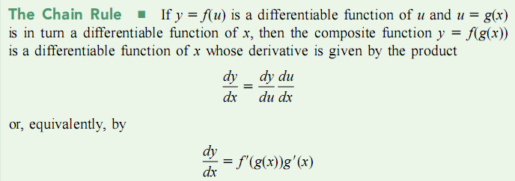
Section 3.6 Chain Rule and derivatives of
Inverse Function
Remark:

Slide 2
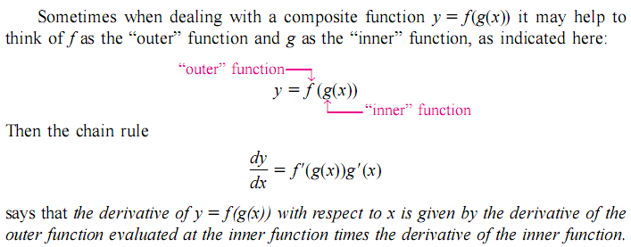
(1) Power Rule:

Slide 3
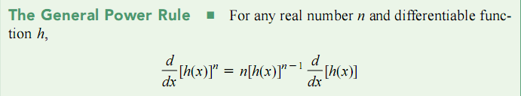

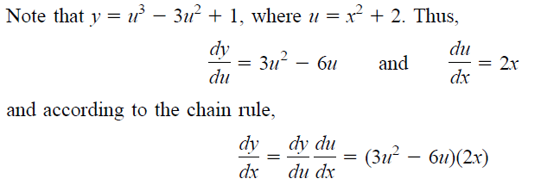
Example 1:
Solution:

Slide 5

Example 4:
Example 5:

Slide 6
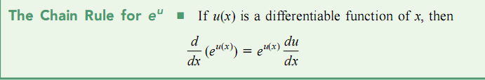

Example 6:
Example 7:

Slide 7
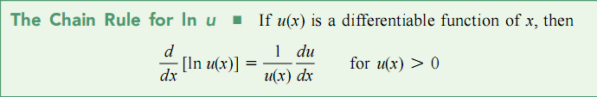

Example 8:
Example 9: If
find
Solution:

Slide 8
Example 10: Find
Solution:
Example 11: If
find
Solution:
Example 12:

Slide 9

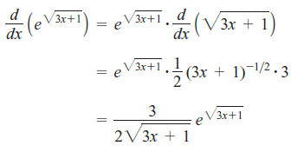
Exercise 1.
2 . If
where
is differentiable , find
Solution:

Slide 10
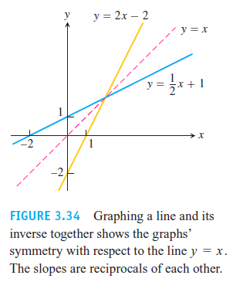
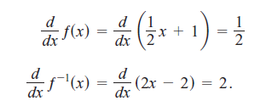
Section 3.8 Derivatives of Inverse Functions

Slide 11
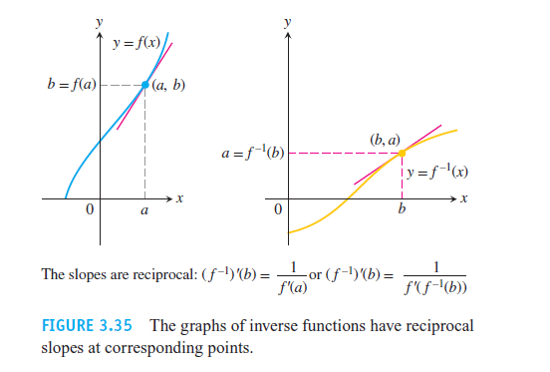
Reflecting any nonhorizontal or nonvertical line across the line y=x always inverts the line’s slope. If the original line has slope m≠0, the reflected line has slope 1/m.

Slide 12
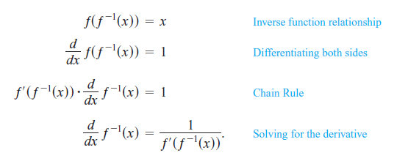

Slide 13
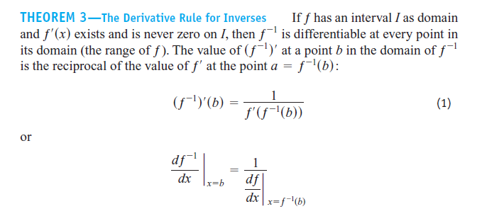

Slide 14
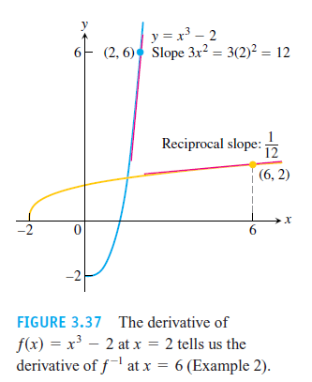

Slide 15
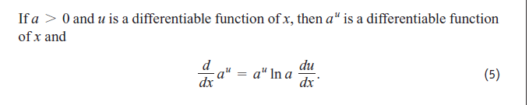
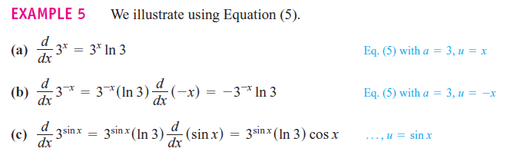

Slide 16
Example 13: For
Solution:
Since
then

Slide 17
Similarly,

Slide 18
Example 14: For
Solution:

Slide 19
Similarly,

Slide 20
1
y
=
arctan
,
'
Example 15: If
find
y
x
Solution:

Slide 21
1. Derivatives for basic functions

Slide 22
2. Differentiation Rules:
( C is a constant )
3. Chain Rule:

Slide 23
Homework: Page 167: 24, 28, 32, 74
Page 184: 36, 40
Page: 191: 36, 40

